Slide 1

Part 1
Embedded Rust Workshop

Slide 2

Our day
Our morning is divided up into:
Introduction
Exploring the Rust embedded ecosystem
Exercise 1
Portable drivers in Rust
Exercise 2

Slide 3
Introduction
Who am I?
Dion Dokter
Bachelor’s Applied Computer Science at Saxion Enschede
Embedded Rust since 2019
Joined TG in Sep-2021
LoRaWAN IoT
UWB Real Time Localization System

Slide 4

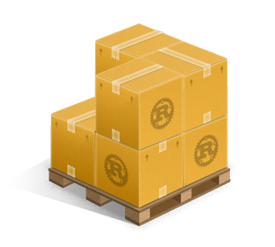



Exploring the Rust embedded ecosystem
Rust, C++, C
core, alloc, std
cargo, crates, rustc
probe-rs

Slide 5
Cortex-m crates
Cortex-m
Peripheral Access Crate
Similar to CMSIS register definitions
Cortex-m-rt
Startup runtime
Interrupt setup

Slide 6
Device PACs
Every device has different peripherals. One PAC for every device.
Generated from SVD
Imported as dependency

Slide 7
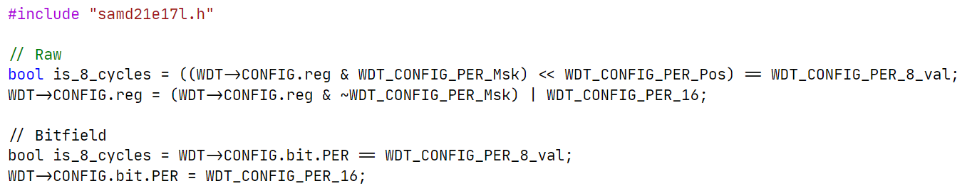
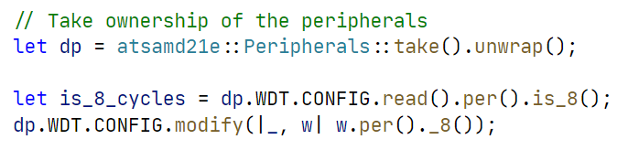
Device PACs
C
Rust

Slide 8
Device HALs
Many open source HALs
Most basic operations supported
Built on top of PACs

Slide 9
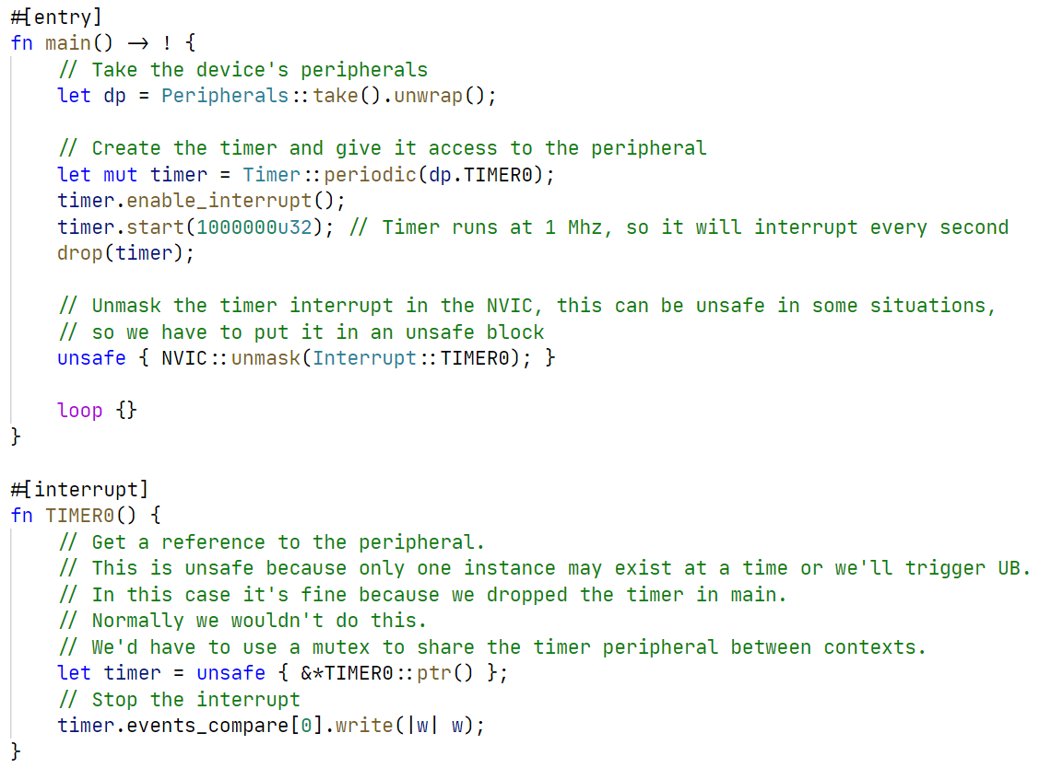
Device HALs

Slide 10
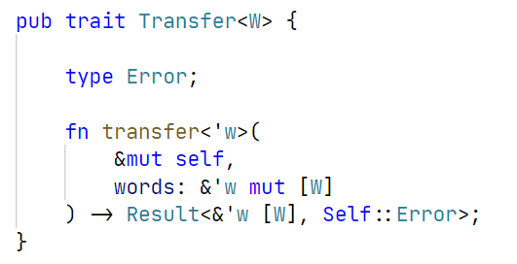
Embedded-hal
The glue of the entire ecosystem
Contains abstractions for many common operations
SPI example trait:

Slide 11
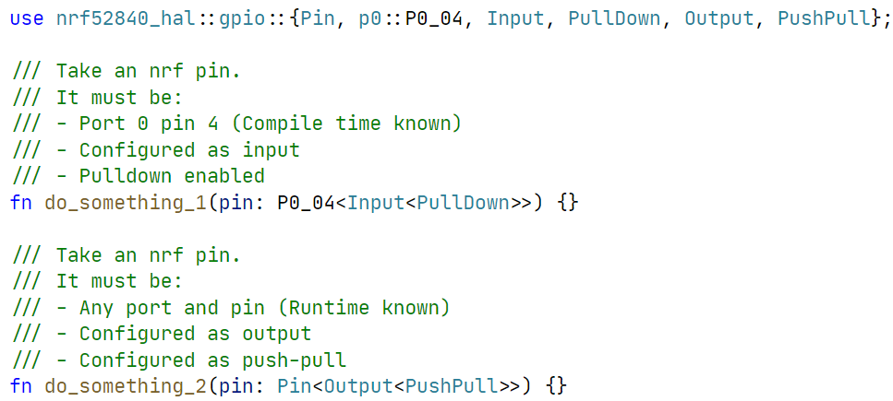
Typestate
State encoded in the type of the variable

Slide 12
Runtimes
Bare metal + interrupts
RTIC
(Real-Time Interrupt-driven Concurrency)
RTOS
Async

Slide 13
Questions so far?
?

Slide 14
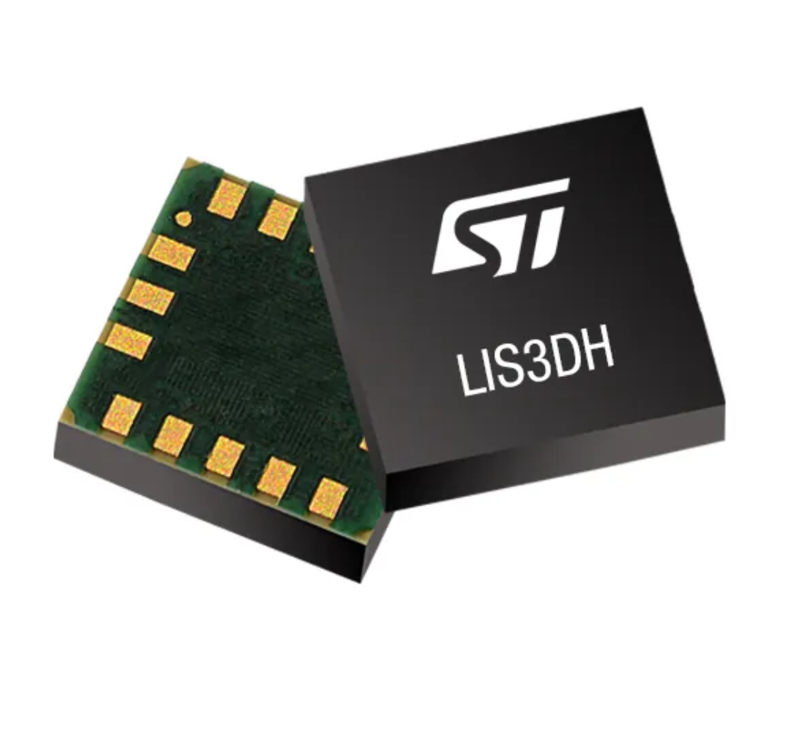
Exercise 1
Meet the LIS3DH
Clone the repository: https://github.com/tweedegolf/workshop-december-2021
Open your favorite text editor in ‘assignments/part_1’
Open the book and read the intructions
We are going to read the ID register of the chip

Slide 15
Solution
How did you solve it?
What were the problems you encountered?
What did you like or dislike?

Slide 16
Portable drivers
We want drivers for devices
We want them to be portable
Abstraction in C?
Abstraction in Rust?
Low level & high level drivers?
A low level driver
Possibilities in Rust

Slide 17
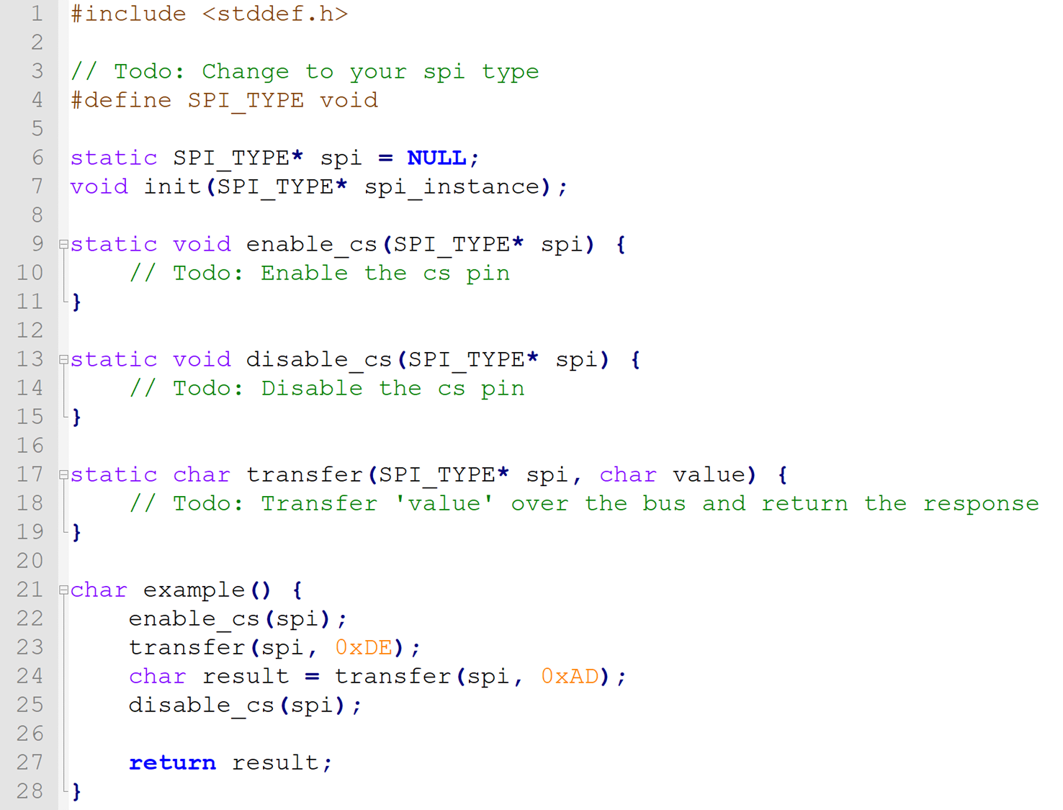
Abstraction in C
Fill-in functions
Efficient
Inconvenient

Slide 18
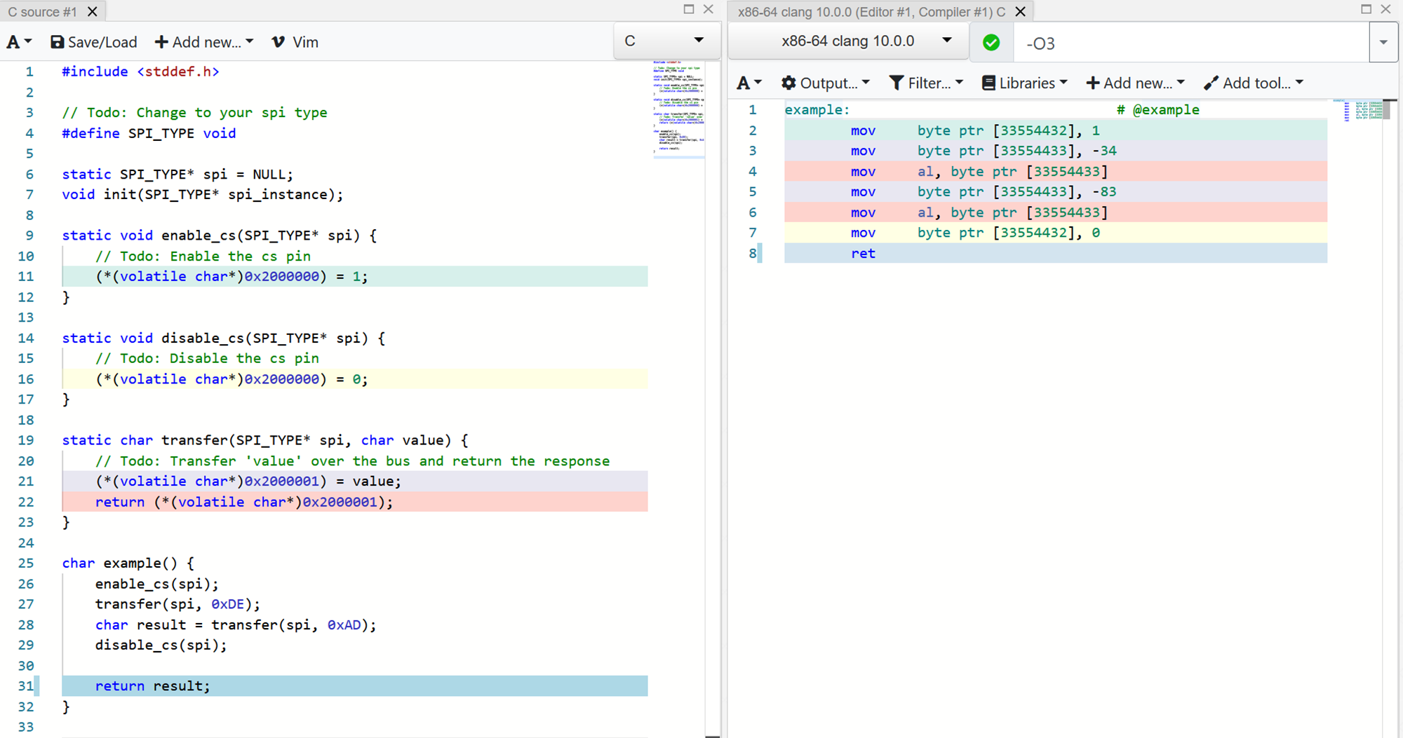

Slide 19
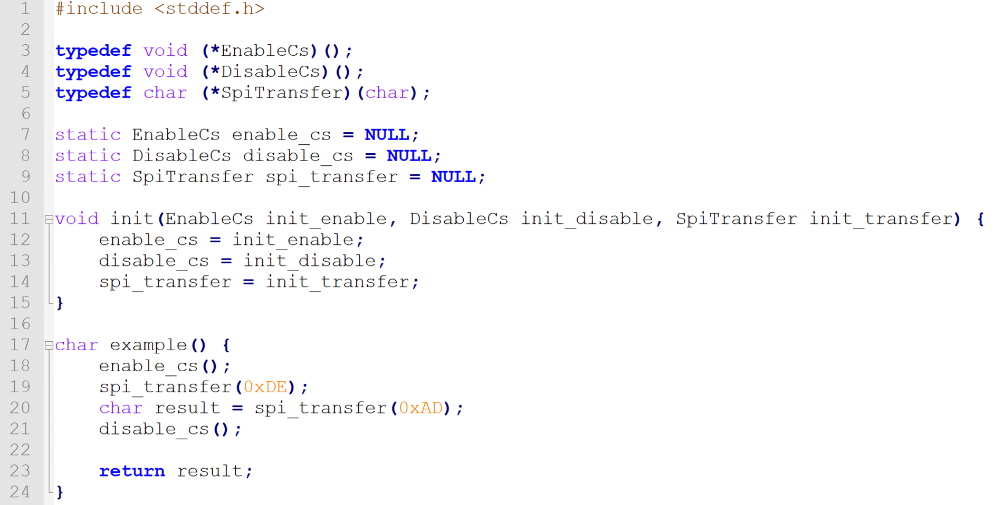
Abstraction in C
Function pointers
Inefficient
Convenient

Slide 20
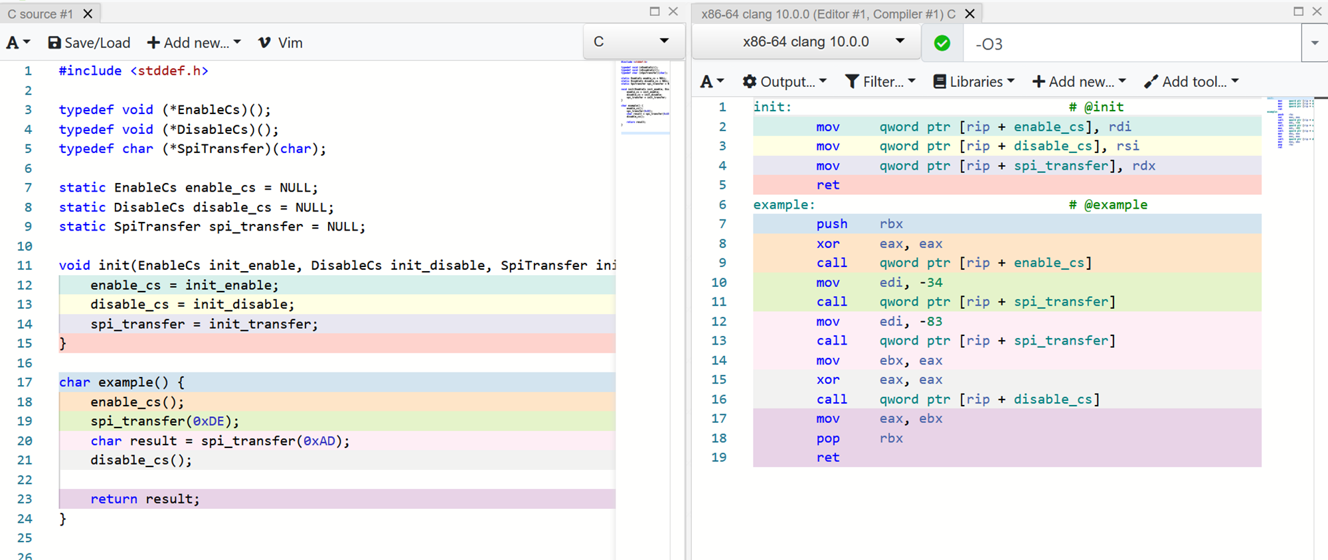

Slide 21
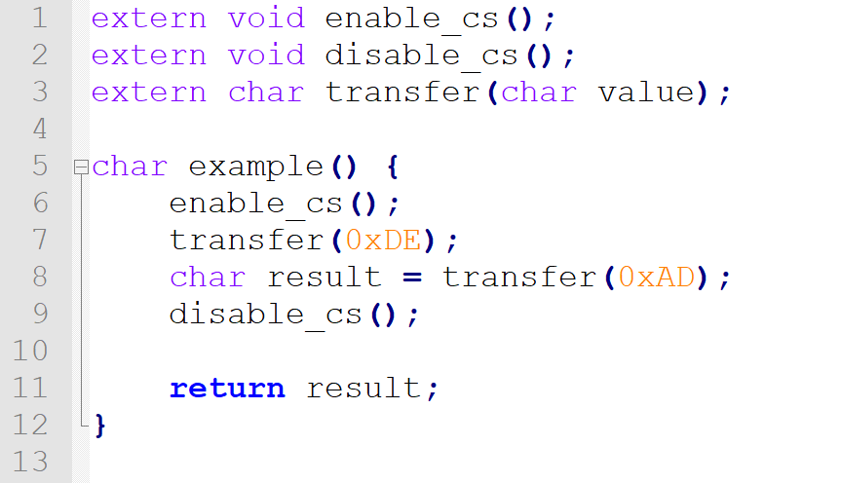
Abstraction in C
Link-time binding
Efficient
Somewhat convenient
Error-prone

Slide 22
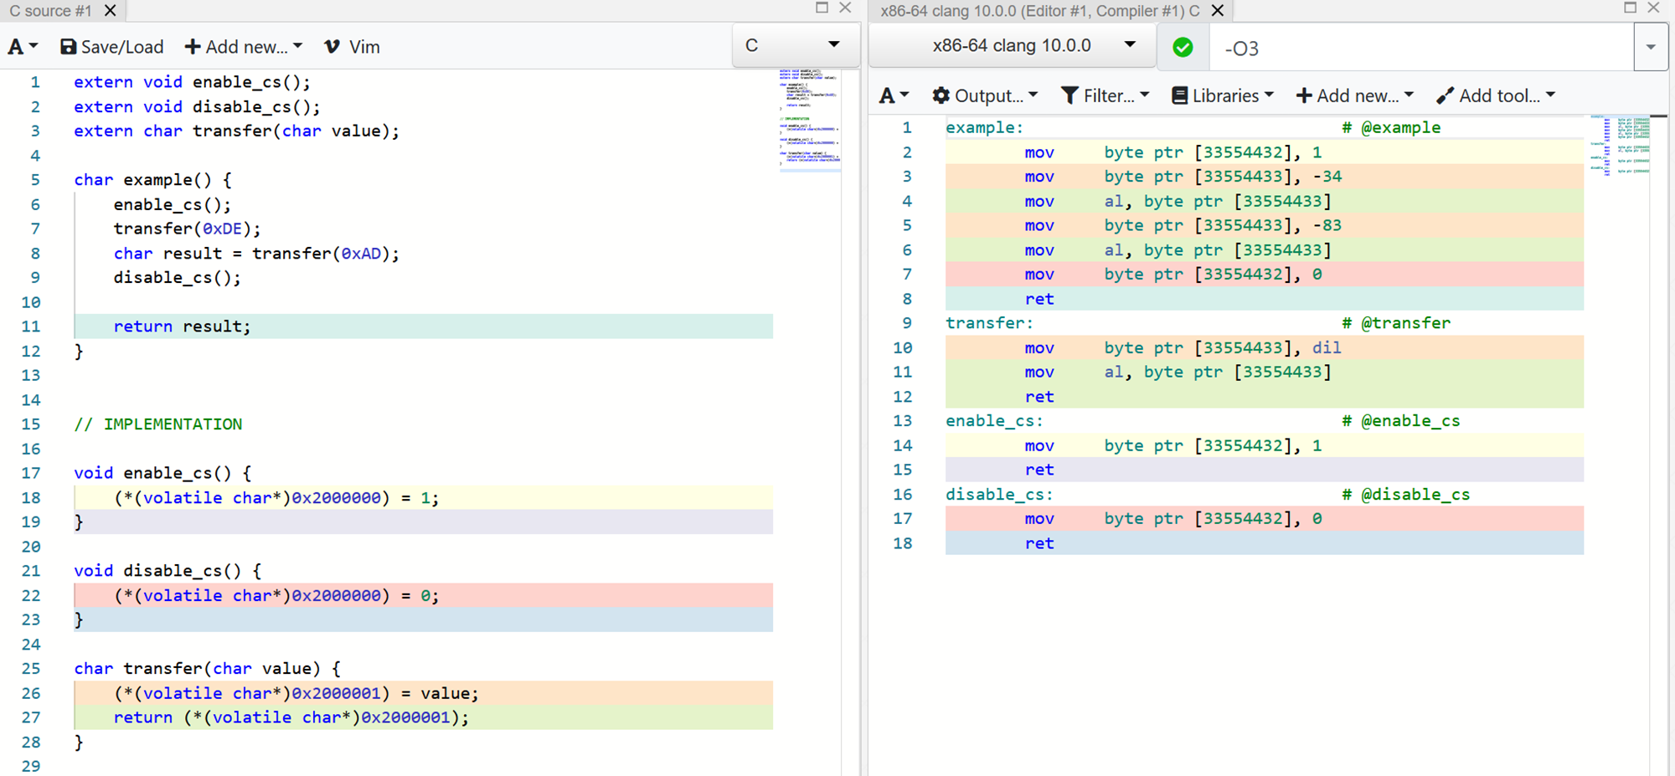

Slide 23
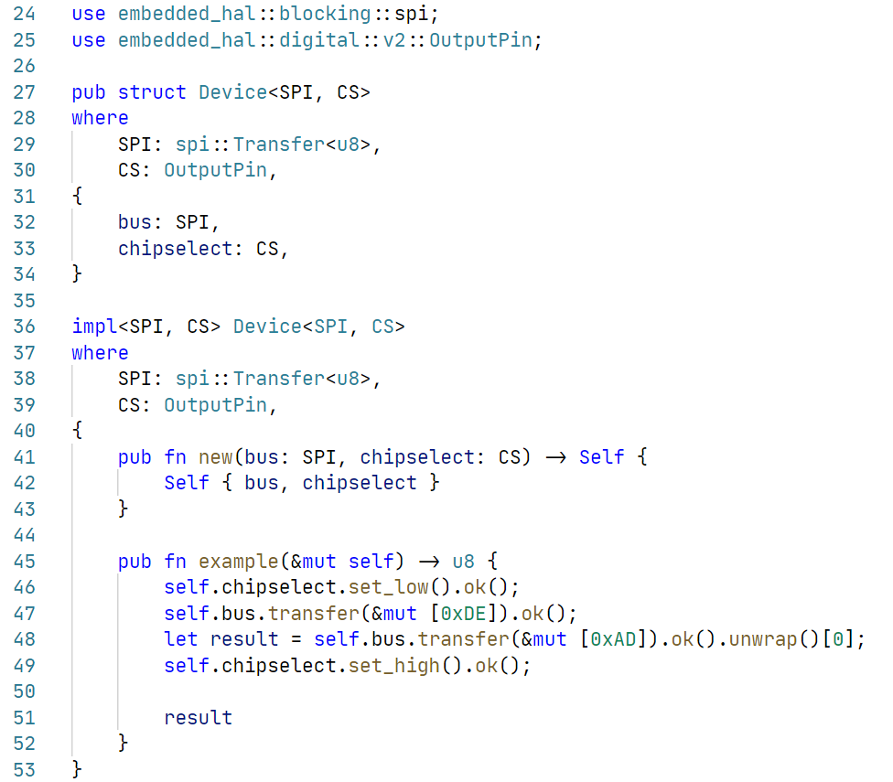
Abstraction in Rust
Traits + generics
Reuse traits from embedded-hal
Efficient
Convenient

Slide 24
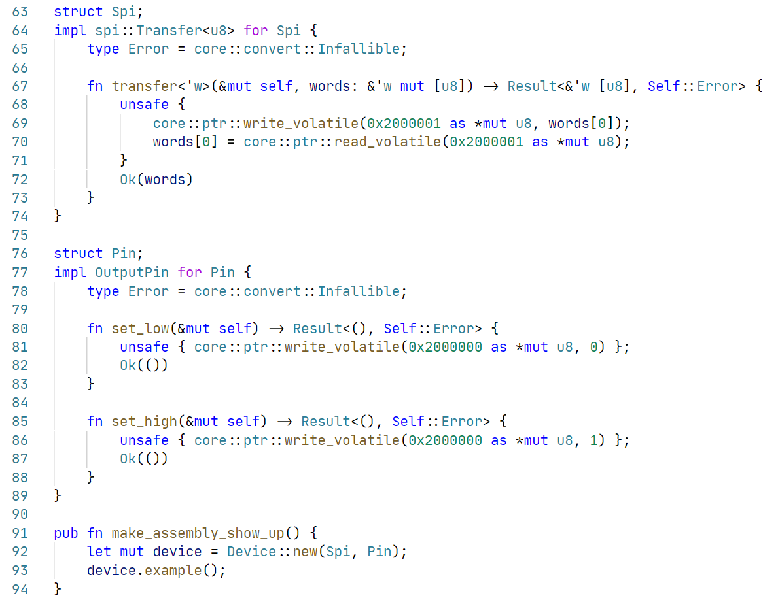
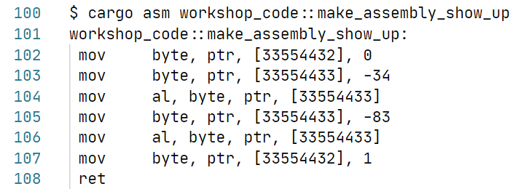

Slide 25
Low level & high level drivers
Low level driver
Hardware abstractions + reading/writing registers
Register/buffer/command definitions
High level driver
Implement common routines
Requirement assertions
Common interface export

Slide 26
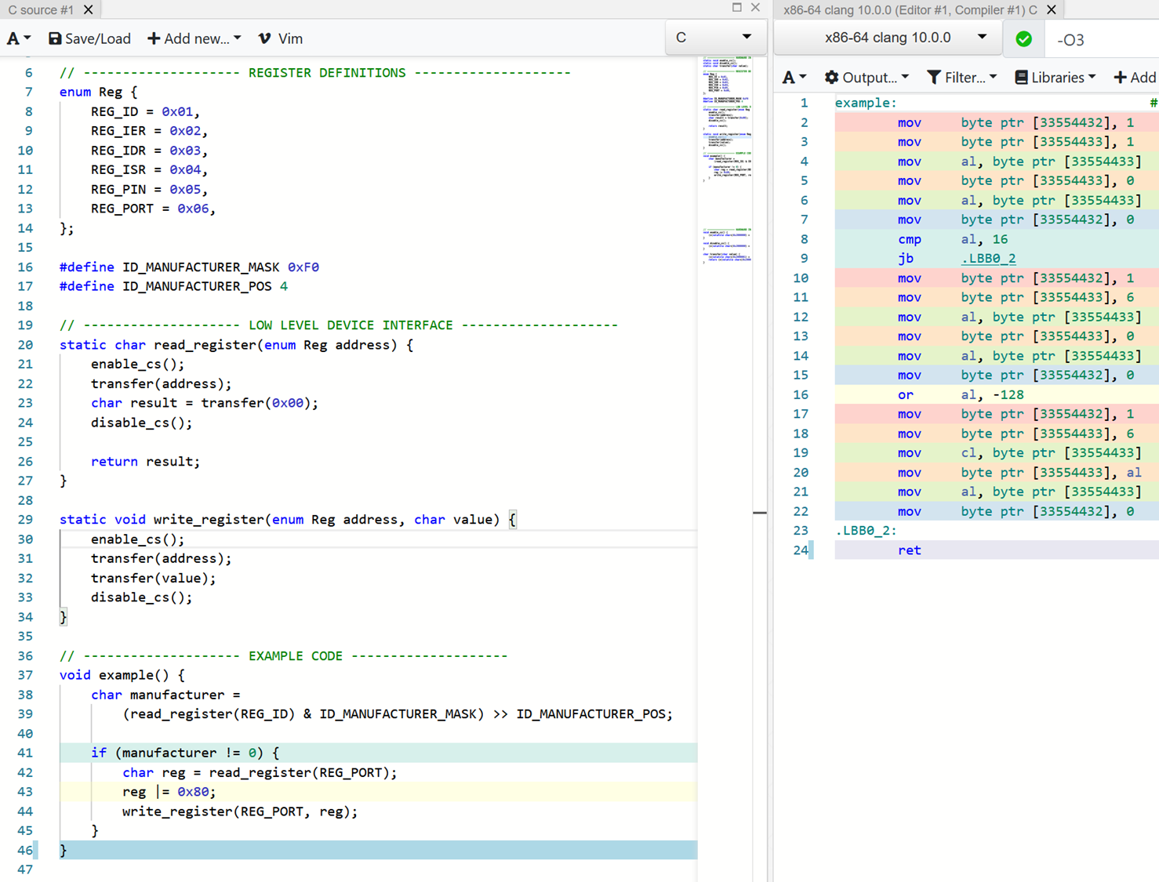
Low level driver in C
Enum & #define for definitions
Functions for read/write

Slide 27
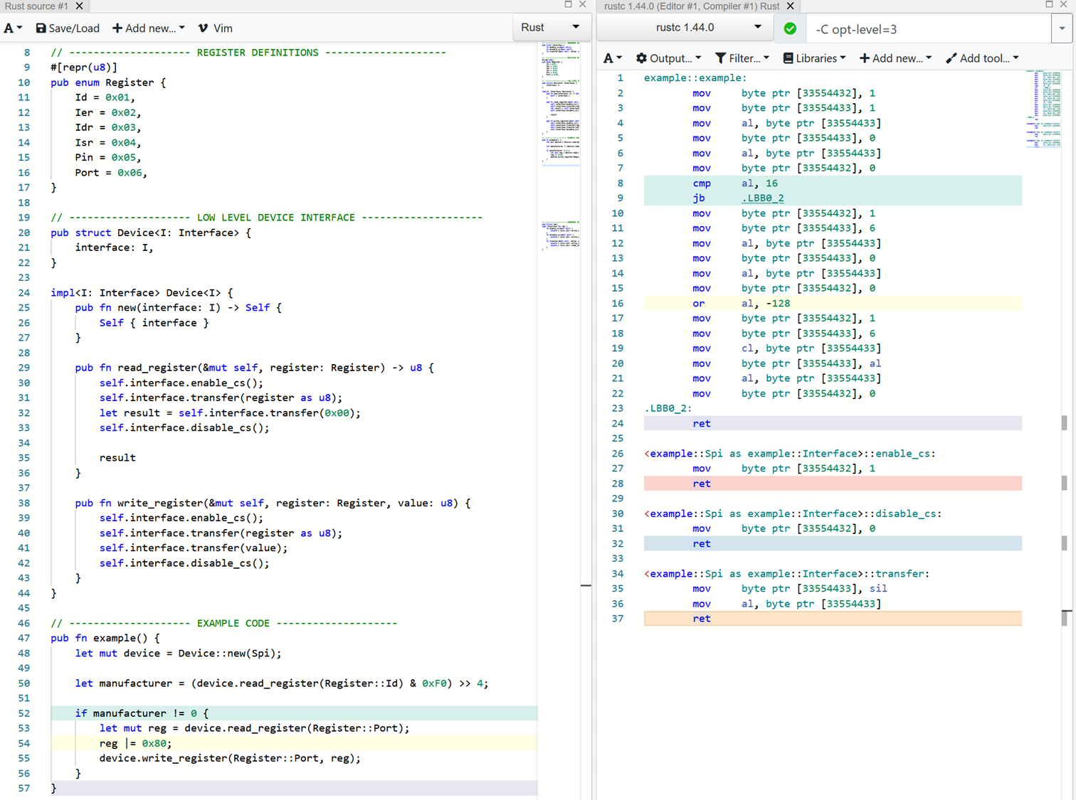
Low level driver in Rust
Enum for definitions
Device struct representing an instance of a chip
Functions for read/write

Slide 28
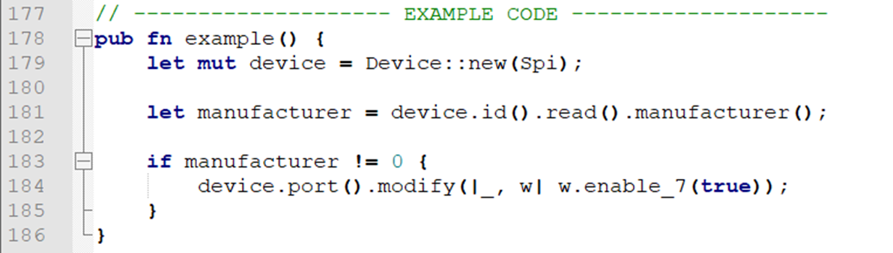
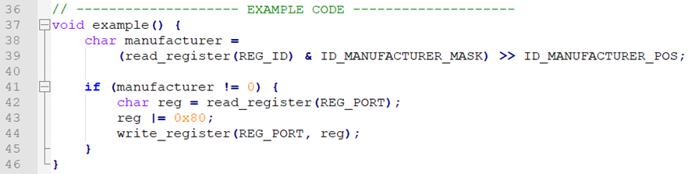
Possibilities in Rust
Much more is possible:

Slide 29
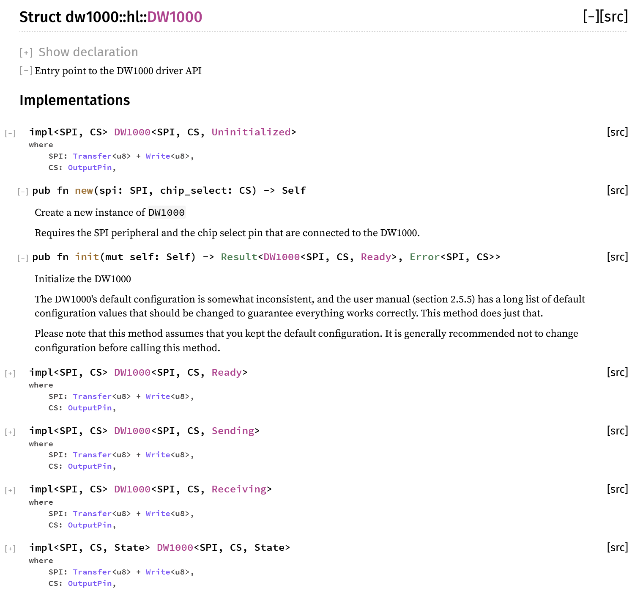
Possibilities in Rust
Add typestate to high level driver

Slide 30
Possibilities in Rust
Much more is possible:
Embedded-hal
Radio
Embedded-nal
Usb-device
Embedded-graphics
Accelerometer
Embedded-storage

Slide 31
Questions so far?
?

Slide 32
Exercise 2
A real driver for the LIS3DH
Open the book and read the intructions

Slide 33
Solution
How did you solve it?
What were the problems you encountered?
What did you like or dislike?

Slide 34

Castellastraat 26, 6512 EX Nijmegen
info@tweedegolf.com
024 3010 484

